Slide 1
Run interactive queries with Azure Synapse Serverless SQL pools

Slide 2
Agenda
Describe Azure Synapse serverless SQL pools
Querying a data lake store using serverless SQL pools in Azure Synapse Analytics
Transforming data with a serverless SQL pool
Notes:
TALKING POINTS
Let’s set an agenda for today’s presentation in which we are going to discuss the following:
Describe Azure Synapse serverless SQL pools
Querying a data lake store using serverless SQL pools in Azure Synapse Analytics
Securing access to data through using serverless SQL pools in Azure Synapse Analytics
PRESENTER NOTES AND GUIDANCE
Don’t take too much time in order to present the agenda. Make the points in the topics.

Slide 3
Azure Synapse Analytics overview
1
Notes:
TALKING POINTS
Let’s go over what Azure Synapse serverless SQL pools is. How many of you have the need to explore data, or perform ad hoc transformation?
PRESENTER NOTES AND GUIDANCE
Poll your audience.

Slide 4
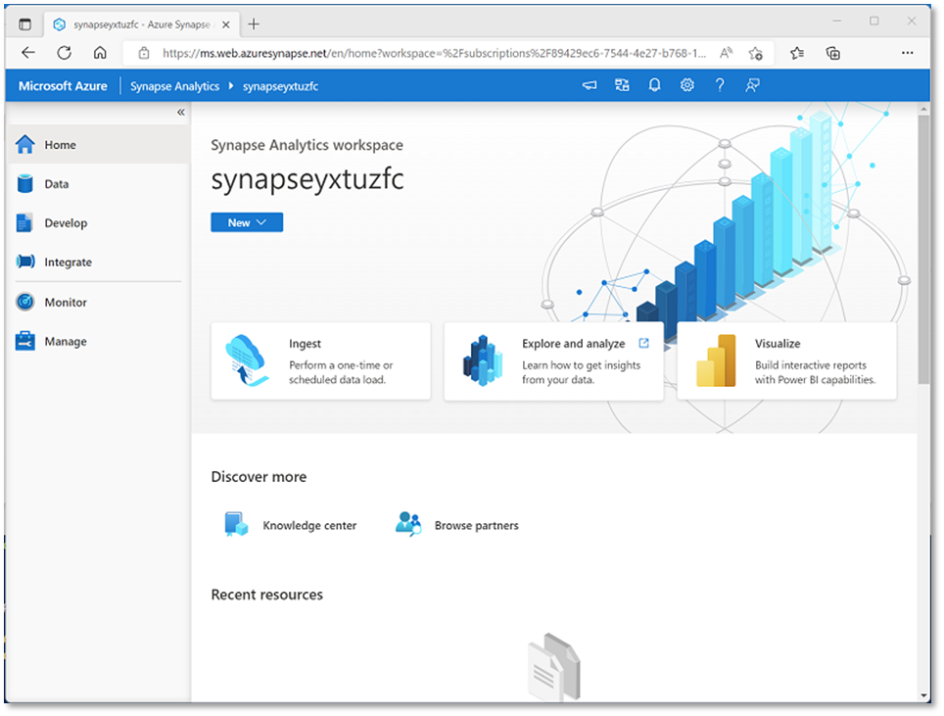
What is Azure Synapse Analytics?
Cloud platform for data analytics
Large-scale data warehousing
Advanced analytics
Data exploration and discovery
Real-time analytics
Data integration
Integrated analytics
Notes:
Azure Synapse Analytics is an Azure service that combines multiple data integration, processing, and analytical capabilities. The core Azure resource is a workspace, but the overall service ca include multiple other Azure resources depending on the capabilities you use. For example, an Azure Storage account resource is created to support a data lake for the workspace, A SQL, Spark, or Data Explorer pool resource is created to provide the compute services for data processing, and other resources may be created to support the overall solution. Data engineers generally don’t need to manage these resources independently, but rather use the Azure Synapse Studio web interface (as shown on the slide) to manage the service as a whole.

Slide 5
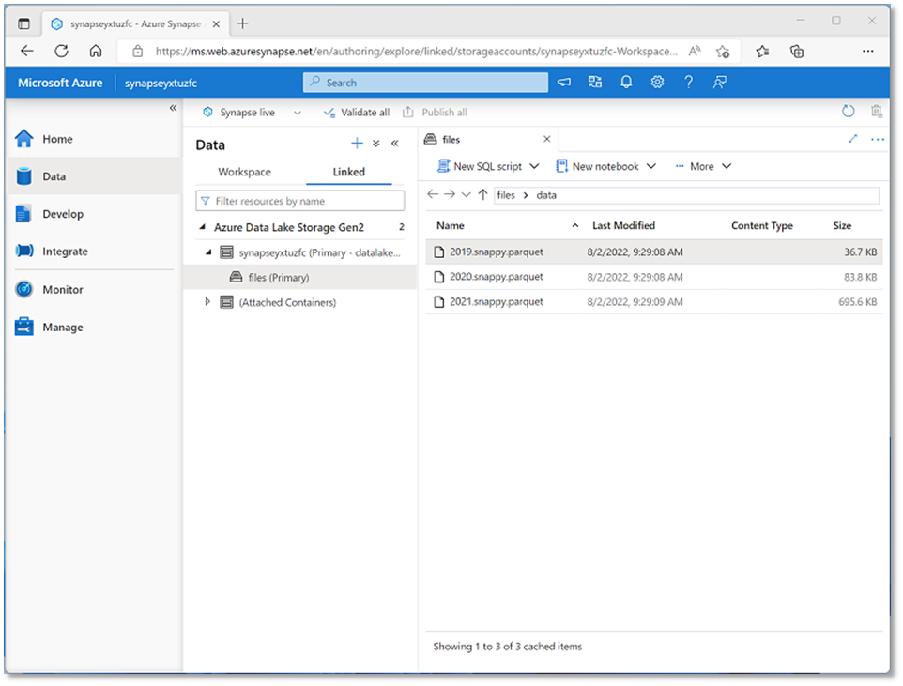
Work with files in a data lake
Connect to data lake storage using linked services
Every Azure Synapse Analytics workspace has a default data lake
Notes:
An Azure Synapse workspace generally has a default (or “primary”) data lake store, implemented as an Azure Data Lake Storage Gen2 container. You can attach multiple data lake sources to the workspace as required. A lot of data engineering tasks involve ingesting data files into the data lake, processing and transforming the files in the data lake, and loading data from data lake files into analytical stores.

Slide 6
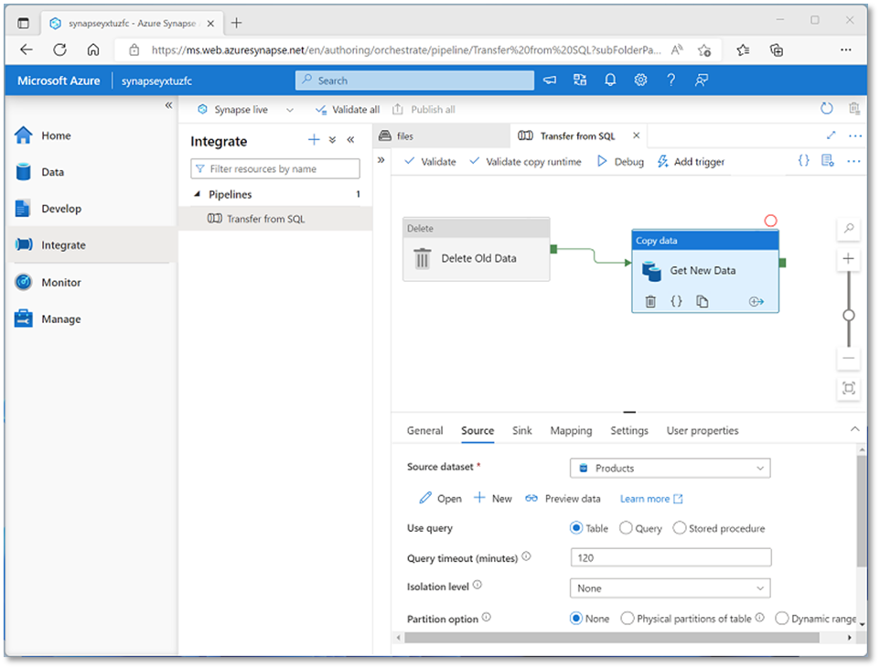
Ingest and transform data with pipelines
Native pipeline functionality built on Azure Data Factory
Orchestrate activities to ingest, transform, and load data
Integrate with other data services
Notes:
If students are already familiar with Azure Data Factory, emphasize that the pipeline functionality in Azure Synapse Analytics is based on the same technology and user experience.
Pipelines are the core integration technology used to implement extract, transform, and load (ETL) or extract, load, and transform (ELT) workloads that bring together data from multiple operational sources into a centralized analytical solution. We’ll explore pipelines in more depth later in the course, so don’t get too deeply into the details here.

Slide 7
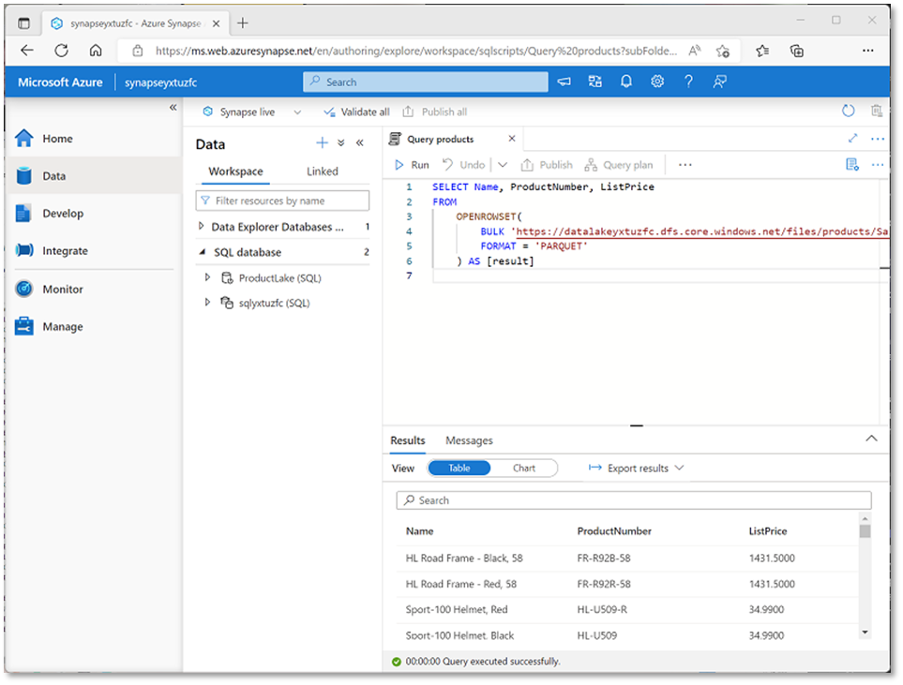
Query and manipulate data with SQL
SQL Server based pools for scalable relational data processing:
    Built-in serverless SQL pool for data exploration and analysis of files in the data lake
    Custom dedicated SQL pools to host large-scale relational data warehouses
Notes:
SQL is a core skill for any data professional, and man students are likely to already be familiar with SQL language and SQL Server based databases. The key point to make here is that Azure Synapse Analytics provides two similar, but distinct SQL services; a default “serverless” pool that is used to apply SQL operations to structured data files in the data lake, and the ability to create multiple “dedicated” SQL pools that are essentially instances of what was previously called Azure SQL Data Warehouse, and which are used to implement enterprise-scale “massively parallel processing” (MPP) relational data warehouses.
We’ll be exploring both of these SQL capabilities later in the course, so don’t get too deeply into the details here.

Slide 8
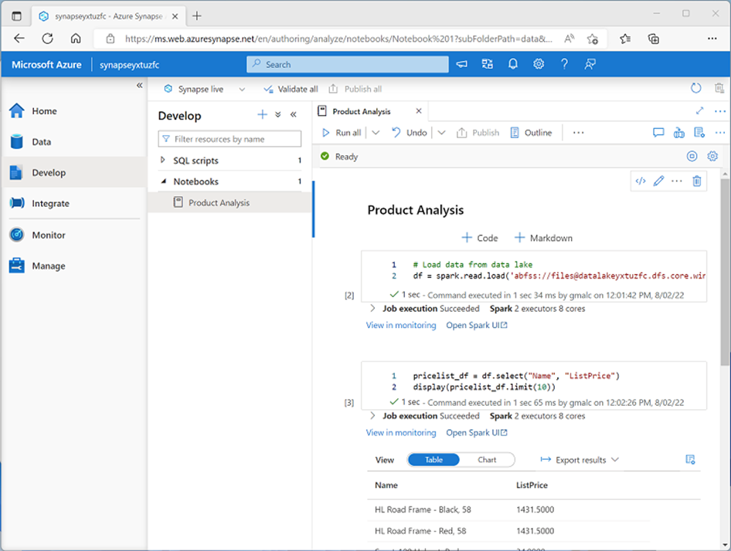
Process and analyze data with Apache Spark
Open-source Spark technology
    Highly scalable, distributed processing
    Common libraries and multiple programming languages
Integrated notebook experience
Notes:
Apache Spark is an open-source platform that evolved from big data technologies like Hadoop and Hive. It’s designed to provide high scalability by distributing data processing across multiple worker nodes in a cluster, and can process jobs that are written in a variety of programming languages, including Python, Scala, Java, SQL and others. While you can run jobs that are submitted as scripts or compiled executables (such as Java JARs), it’s extremely common for data engineers (and data analysts, data scientists, and other data professionals) to use Spark interactively through notebooks.
Azure Synapse Analytics provides the ability to create one or more Spark pools (dynamically managed clusters) and use integrated notebook functionality in Azure Synapse Studio to run data processing and analysis jobs. We’ll be exploring Spark in Azure Synapse Analytics in greater depth later in the course.

Slide 9
Querying a data lake store using serverless SQL pools in Azure Synapse Analytics
2
Notes:
Talking Points:
Let’s look at how you can query the common files that are stored in an Azure Data Lake

Slide 10
Synapse serverless SQL pools
Logical data warehouse
Create objects (such as VIEWs and External Tables) that provide you with a SQL metadata layer over the data in the lake to create a logical data warehouse. Once these objects are created, any tool that can connect to serverless SQL pool will see these objects as regular SQL Server objects
Every Azure Synapse Analytics workspace comes with serverless SQL pool endpoints so you can start querying data in seconds to minutes in a data lake as soon as the workspace is created. There's no infrastructure to setup or clusters to maintain.
Data Exploration
Data transformation
Browse the data lake and get initial insights about the data. Using Azure Synapse Studio, you can explore the data both graphically and programmatically.
Serverless SQL pool enables you to execute transformation statements over the data in the lake and store the results back to the data lake in a specified file format.
Notes:
Every Azure Synapse Analytics workspace comes with a built in serverless SQL pool endpoint that you can be used to query files in a data lake.
Serverless SQL pool is serverless, hence there's no infrastructure to setup or clusters to maintain. A default endpoint for this service is provided within every Azure Synapse workspace, so you can start querying data as soon as the workspace is created. There is no charge for resources reserved, you are only being charged for the data processed by queries you run; so this model is a true pay-per-use model.
If you use Apache Spark for Azure Synapse in your data pipeline, for data preparation, cleansing or enrichment, you can query external Spark tables you've created in the process, directly from serverless SQL pool. Use Private Link to bring your serverless SQL pool endpoint into your managed workspace VNet.

Slide 11
Azure Synapse Serverless SQL Pools
Every Azure Synapse Analytics workspace comes with serverless SQL pool endpoints so you can start querying data in seconds to minutes in a data lake as soon as the workspace is created. There's no infrastructure to setup or clusters to maintain.
Notes:
TALKING POINTS
Every Azure Synapse Analytics workspace comes with serverless SQL pool endpoints that you can use to query data in the lake.
Serverless SQL pool is a query service over the data in your data lake. It enables you to access your data through the following functionalities:
A familiar T-SQL syntax to query data in place without the need to copy or load data into a specialized store.
Integrated connectivity via the T-SQL interface that offers a wide range of business intelligence and ad-hoc querying tools, including the most popular drivers.
Serverless SQL pool is a distributed data processing system, built for large-scale data and computational functions. Serverless SQL pool enables you to analyze your Big Data in seconds to minutes, depending on the workload. Thanks to built-in query execution fault-tolerance, the system provides high reliability and success rates even for long-running queries involving large data sets.
Serverless SQL pool is serverless, hence there's no infrastructure to setup or clusters to maintain. A default endpoint for this service is provided within every Azure Synapse workspace, so you can start querying data as soon as the workspace is created.
There is no charge for resources reserved, you are only being charged for the data processed by queries you run, hence this model is a true pay-per-use model.
If you use Apache Spark for Azure Synapse in your data pipeline, for data preparation, cleansing or enrichment, you can query external Spark tables you've created in the process, directly from serverless SQL pool. Use Private Link to bring your serverless SQL pool endpoint into your managed workspace VNet.
PRESENTER NOTES AND GUIDANCE
Review the following page for introductory information:
Serverless SQL pool - Azure Synapse Analytics | Microsoft Docs

Slide 12

Comparing dedicated SQL Pools with serverless SQL pools in
Azure Synapse Analytics
Dedicated SQL Pool
Serverless SQL Pool
Cloud-scale relational database
Data stored in relational tables
Used for Data Warehouse operations
Provides predictable performance and costs
Reserves processing power for data stored in SQL tables
Typical use cases:
  Relational data warehouse
  Enterprise business intelligence
On-demand SQL query processing
Data stored as files in a data lake
Used for data preparation or ad-hoc queries against unstructured data.
Provides an always available SQL endpoint for unplanned workloads
Enables interactive querying
Typical use cases:
  Data exploration
  Data transformation
  Logical data warehouse
Notes:
TALKING POINTS
Synapse SQL offers both serverless and dedicated resource models, offering consumption and billing options to fit your needs. For predictable performance and cost, provision pools to reserve processing power for data stored in SQL tables. For unplanned or bursty workloads, use the serverless, always-available SQL endpoint.

Slide 13
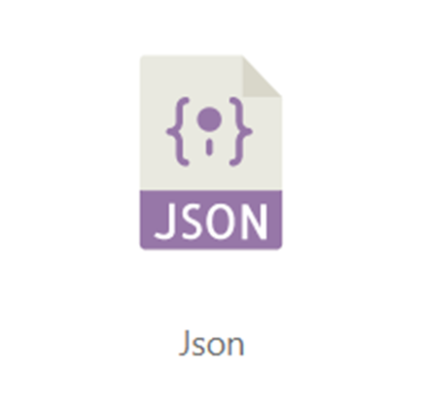
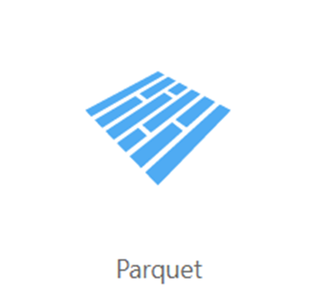
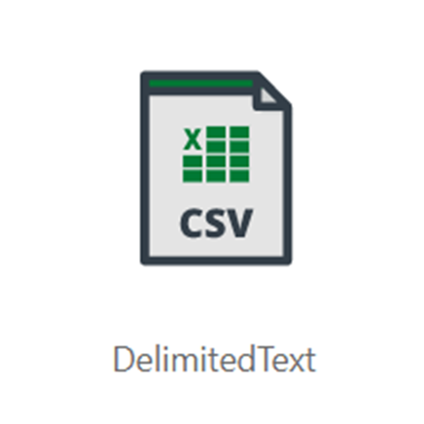
Common files to query
Parquet
JSON
Delimited Text
Notes:
TALKING POINTS
Serverless SQL pool enables you to query data in your data lake. It offers a T-SQL query surface area that accommodates semi-structured and unstructured data queries. For querying, the following T-SQL aspects are supported:
- Full SELECT surface area, including majority of SQL functions and operators.
- CREATE EXTERNAL TABLE AS SELECT (CETAS) creates an external table and then exports, in parallel, the results of a Transact-SQL SELECT statement to Azure Storage.
To support a smooth experience for in place querying of data that's located in Azure Storage files, serverless SQL pool uses the OPENROWSET function with additional capabilities:
- Query multiple files or folders
- PARQUET file format
- Query CSV and delimited text (field terminator, row terminator, escape char)
- Read a chosen subset of columns
- Schema inference
- filename function
- filepath function
- Work with complex types and nested or repeated data structures
Full details can be explored here:
Query data storage with serverless SQL pool (preview) - Azure Synapse Analytics | Microsoft Docs

Slide 14
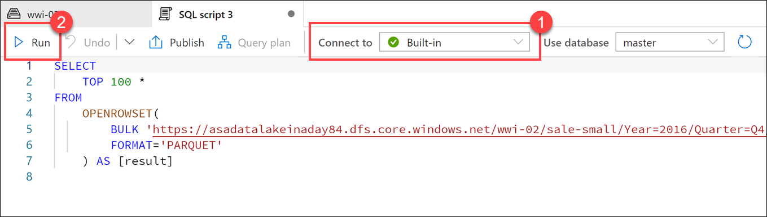
Query data in the lake using Azure Synapse serverless SQL pools
Notes:
Serverless SQL pools enable you to query data in your data lake. They offer a T-SQL query surface area that accommodates semi-structured and unstructured data queries. For querying, the following T-SQL aspects are supported:
- Full SELECT surface area, including a majority of SQL functions and operators.
- CREATE EXTERNAL TABLE AS SELECT (CETAS) creates an external table and then exports, in parallel, the results of a Transact-SQL SELECT statement to Azure Storage.
To support a smooth experience for in-place querying of data that's located in Azure Storage files, serverless SQL pool uses the OPENROWSET function with additional capabilities including:
- Query multiple files or folders
- Query PARQUET file format
- Query CSV and delimited text (field terminator, row terminator, escape char)
- Read a chosen subset of columns
- Use schema inference
- Use the filename function
- Use the filepath function
- Work with complex types and nested or repeated data structures

Slide 15
Querying parquet files in a data lake
Notes:
TALKING POINTS
Understanding data through data exploration is one of the core challenges faced today by data engineers and data scientists as well. Depending on the underlying structure of the data as well as the specific requirements of the exploration process, different data processing engines will offer varying degrees of performance, complexity, and flexibility.
In Azure Synapse Analytics, you can use either SQL, Apache Spark for Synapse, or both. Which service you use mostly depends on your personal preference and expertise. When conducting data engineering tasks, both options can be equally valid in many cases. However, there are certain situations where harnessing the power of Apache Spark can help you overcome problems with the source data. This is because in a Synapse
Notebook, you can import from a large number of free libraries that add functionality to your environment when working with data. There are other situations where it is much more convenient and faster using serverless SQL pool to explore the data, or to expose data in the data lake through a SQL view that can be accessed from external tools, like Power BI.
- In Synapse Studio, navigate to the Data hub.
- Select the Linked tab and expand Azure Data Lake Storage Gen2. Expand the primary ADLS Gen2 account and select the container. Navigate to the folder, and right-click on the parquet file, select New SQL script, then Select TOP 100 rows.
- As per the screenshot in the slide, Ensure Built-in is selected (1) in the Connect to dropdown list above the query window, then run the query (2). Data is loaded by the serverless SQL endpoint and processed as if was coming from any regular relational database.

Slide 16
Query delimited text files using a serverless SQL pool
Use the OPENROWSET function
  Use the BULK parameter specifies file path(s)
  Include wildcards as required
  Use the FORMAT parameter to specify ‘csv’
  Use additional parameters for:
  Header row
  Delimiter characters
  Parser version
  others…
  Use the WITH clause to specify column names and types
123,Widget,12.99
124,Gadget,3.99
…
SELECT *
FROM OPENROWSET(
BULK 'https://.../data/files/*.csv',
FORMAT = 'csv',
PARSER_VERSION = '2.0')
WITH (
product_id INT,
product_name VARCHAR(20),
list_price DECIMAL(5,2)
) AS rows
product_id | product_name | list_price
123 | Widget | 12.99
124 | Gadget | 3.99
… | … | …
Notes:
The primary SQL function used to query files in a data lake is OPENROWSET. It essentially returns a tabular dataset based on data in a file system location, either deriving the tabular schema from the data itself or by applying an explicit schema of column definitions. For delimited files, you can specify explicit delimiters (tab, comma, space, etc.). The default field delimiter is comma.
Talk through the code example, which opens data from a specified CSV file and returns it as a tabular dataset based on the schema defined in the WITH clause.

Slide 17
Query JSON files using a serverless SQL pool
Use the OPENROWSET function
  Use the BULK parameter specifies file path(s)
  Include wildcards as required
  Use the FORMAT parameter to specify ‘csv’
  Set terminators to '0x0b’ (vertical tab)
  Use the WITH clause to specify a single NVARCHAR column
  Use JSON_VALUE function to specify JSON properties
  Specify attribute path based on JSON in the NVARCHAR column
{
"product_id": 123,
"product_name": "Widget",
"list_price": 12.99
}
SELECT JSON_VALUE(doc, '$.product_name') AS product,
JSON_VALUE(doc, '$.list_price') AS price
FROM
OPENROWSET(
BULK 'https://.../data/files/*.json',
FORMAT = 'csv',
FIELDTERMINATOR ='0x0b',
FIELDQUOTE = '0x0b',
ROWTERMINATOR = '0x0b'
) WITH (doc NVARCHAR(MAX)) as rows
product | price
Widget | 12.99
Gadget | 3.99
… | …
Notes:
The key point here is that there’s no specific JSON format. JSON files are treated as delimited files with specific delimiters, and the object path syntax in the JSON_VALUE function is used to navigate the JSON document hierarchy based on the resulting rowset (which consists of rows containing text values for JSON objects)

Slide 18


Query parquet files using a serverless SQL pool
Use the OPENROWSET function
  Use the BULK parameter specifies file path(s)
  Include wildcards as required
  Use the FORMAT parameter to specify ‘parquet’
  Use filepath property to filter by partitions
  Parameters reflect ordinal position of wildcards
  Not specific to parquet, but commonly used to distribute data in parquet format
orders
year=2020
month=1
month=2
SELECT *
FROM OPENROWSET(
BULK 'https://.../data/orders/year=*/month=*/*.*’,
FORMAT = 'parquet’) AS orders
WHERE orders.filepath(1) = '2020’
AND orders.filepath(2) IN ('1','2');
order_no | order_date | order_total
1001 | 2020-01-07 | 99.78
1002 | 2020-01-12 | 11.99
… | … | …
Notes:
Parquet is generally the preferred format for working with data files in a data lake because of its efficient compression format and support across big data processing platforms (a lot of data engineering tasks involve transforming data from other formats into Parquet). Note that in most cases, the schema is embedded in the Parquet file, so a WITH clause isn’t required.
Partitioning is a technique that’s not specific to Parquet, but which is commonly used to improve scalability and performance in partnership with the optimizations inherent in the Parquet format.

Slide 19
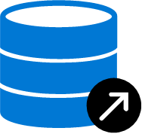



  CREATE DATABASE [YourDatabaseName]
Database
Create metadata objects in Azure Synapse serverless SQL pools
  CREATE DATABASE SCOPED CREDENTIAL [sqlondemand]
  WITH IDENTITY='SHARED ACCESS SIGNATURE',
  SECRET = 'sv=2018-03-28&ss=bf&srt=sco&sp=rl&'
Database
scoped credential
  CREATE EXTERNAL DATA SOURCE SqlOnDemandDemo WITH (
  LOCATION = 'https://sqlondemandstorage.blob.core.windows.net',
  CREDENTIAL = sqlondemand );
External data source
  CREATE EXTERNAL FILE FORMAT QuotedCsvWithHeaderFormat
  WITH
  ( FORMAT_TYPE = DELIMITEDTEXT,
  FORMAT_OPTIONS ( FIELD_TERMINATOR = ',', STRING_DELIMITER = '"', FIRST_ROW = 2 ) );
External file format
  CREATE EXTERNAL TABLE populationExternalTable
  ( [country_name] VARCHAR (100) COLLATE Latin1_General_BIN2,
  [year] smallint, [population] bigint )
  WITH
  ( LOCATION = 'csv/population/population.csv’,
  DATA_SOURCE = sqlondemanddemo,
  FILE_FORMAT = QuotedCSVWithHeaderFormat );
External Table
Notes:
Metadata objects help you query data or optimize your existing data transformation pipeline through Azure Synapse serverless SQL pools. It also enables clients connecting to the serverless SQL pool to discover the objects to query the data in the lake. This essentially creates a semantic layer over which tools like Power BI can use to easily consume the data.
(Click) You should start of by creating a database, and then you can create the following objects to organise the data so that it can be accessed securely:
(Click) Database scoped credential
(Click) External data source
(Click) External file formats
(Click) External tables
(Click) Views
Metadata objects can help you simplify understanding the data that is held in the files of a data lake by enabling you to define a semantic layer on top of the files. This initial step can also simplify the transformation that you may use against the data as it can be presented as tables in the serverless SQL pool.
The ability to create metadata objects within a serverless SQL pools in Azure Synapse Analytics provides some opportunities for customers to use it as a proof-of-concept layer for any potential enterprise data warehouses that they may consider creating. It is important to note; however, that it is better to transition the proof of concept to a dedicated SQL pools where the data and resources are persisted should the proof-of-concept be a success, and the decision is made to make the enterprise data warehouse more permanent.

Slide 20
Transforming data with a serverless SQL pool
3
Notes:
Talking Points:

Slide 21

Securing access to data in a data lake when using Azure Synapse Analytics
Authentication
Authorization
Encryption
Notes:
Talking Points:
There are 3 areas of security to be aware of with Azure Synapse SQL pools
Authentication is the process of proving the user is who they claim to be. A user connects to a database using a user account. When a user attempts to connect to a database, they provide a user account and authentication information. The user is authenticated using one of the following two authentication methods:
SQL authentication.
With this authentication method, the user submits a user account name and associated password to establish a connection. This password is stored in the master database for user accounts linked to a login or stored in the database containing the user accounts not linked to a login.
Azure Active Directory Authentication
With this authentication method, the user submits a user account name and requests that the service use the credential information stored in Azure Active Directory (Azure AD).
Logins and users: A user account in a database can be associated with a login that is stored in the master database or can be a user name that is stored in an individual database.
A login is an individual account in the master database, to which a user account in one or more databases can be linked. With a login, the credential information for the user account is stored with the login.
A user account is an individual account in any database that may be, but does not have to be, linked to a login. With a user account that is not linked to a login, the credential information is stored with the user account.
Authorization to access data and perform various actions are managed using database roles and explicit permissions. Authorization refers to the permissions assigned to a user, and determines what that user is allowed to do. Authorization is controlled by your user account's database role memberships and object-level permissions. As a best practice, you should grant users the least privileges necessary.
Transparent data encryption (TDE) helps protect Azure Synapse Analytics against the threat of malicious offline activity by encrypting data at rest. TDE must be manually enabled for Azure Synapse Analytics. TDE performs real-time I/O encryption and decryption of the data at the page level. Each page is decrypted when it's read into memory and then encrypted before being written to disk. TDE encrypts the storage of an entire database by using a symmetric key called the Database Encryption Key (DEK). On database startup, the encrypted DEK is decrypted and then used for decryption and re-encryption of the database files in the SQL Server database engine process. DEK is protected by the TDE protector. TDE protector is either a service-managed certificate (service-managed transparent data encryption) or an asymmetric key stored in Azure Key Vault (customer-managed transparent data encryption).

Slide 22
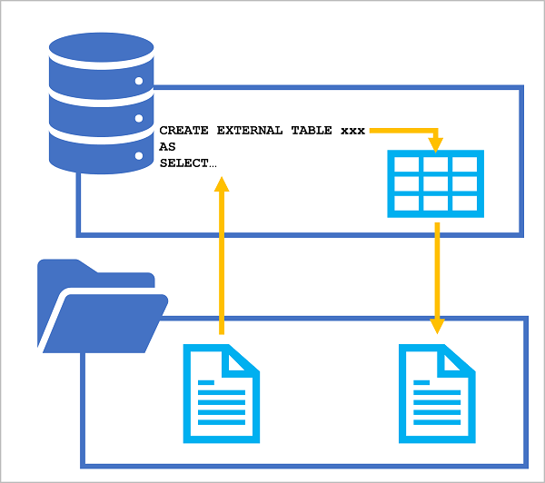
The CREATE EXTERNAL TABLE AS SELECT (CETAS) statement
CREATE EXTERNAL TABLE SpecialOrders
WITH (
-- details for storing results
LOCATION = 'special_orders/',
DATA_SOURCE = files,
FILE_FORMAT = ParquetFormat
)
AS
SELECT OrderID, CustomerName, OrderTotal
FROM
OPENROWSET (
-- details for reading source files
BULK 'sales_orders/*.csv',
DATA_SOURCE = 'files',
FORMAT = 'CSV',
PARSER_VERSION = '2.0',
HEADER_ROW = TRUE
) AS source_data
WHERE OrderType = 'Special Order';
Source data
Transformed data
(CSV or parquet)
Notes:
The CETAS statement provides a convenient way to use the results of a SQL query as the basis for a new external table, which is persisted as one or more data files in the data lake. You can use the SQL query to transform the data, and then query the resulting table or use the underlying data files in a downstream process.

Slide 23

Encapsulate data transformations in a stored procedure
CREATE PROCEDURE Transform_Data @order_year INT
AS
BEGIN
-- Drop the table if it already exists
IF EXISTS (
SELECT * FROM sys.external_tables
WHERE name = 'SpecialOrders'
)
DROP EXTERNAL TABLE SpecialOrders
-- Create external table
CREATE EXTERNAL TABLE SpecialOrders
WITH (
...
)
END
Using a stored procedure:
  Reduces client to server network traffic
  Provides a security boundary
  Eases maintenance
  Improved performance
Dropping the table doesn’t delete the underlying files
Notes:
Using a stored procedure to encapsulate the CETAS transformation makes it easier to reuse the logic as part of a regular data ingestion and transformation process. However, note that dropping the external table does not delete the underlying files; so your repeated process must take that into account. One approach would be to use a dynamically generated file path each time the stored procedure is run. Another is to delete the old files from previous transformation operations (assuming they’re no longer required) before running the stored procedure – this approach is discussed in the next slide.

Slide 24
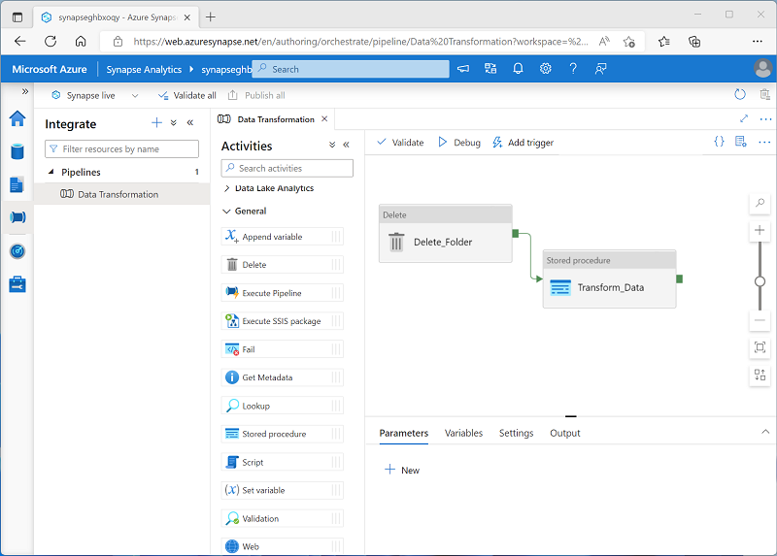
Include a data transformation stored procedure in a pipeline
Create a pipeline with the following activities:
A Delete activity that deletes the target folder for the transformed data in the data lake if it already exists.
A Stored procedure activity that connects to your serverless SQL pool and runs the stored procedure that encapsulates your CETAS operation.
Notes:
We’ll cover pipelines in greater depth later in the course, but for now, point out that by chaining delete and stored procedure activities in a pipeline like this, you can create a repeatable process for using a CETAS statement to transform data and generate new data files in the data lake, which could then be used in a downstream process (for example, to load a table in a dedicated SQL pool)

Slide 25
LAB 2: Query files using a serverless SQL pool
60 minutes
Notes:
TALKING POINTS​
​
Let’s put this into reality and show you how it works.​
​
All instructions and context are found in this repository​

